Slide 1

Chapter 6 Part 1
Normalization
The slides in this presentation have been adapted from slides provided with the textbook, Database Systems: Design, Implementation, and Management,
12E, Cornel and Morris, Copyright © 2017 Cengage Learning.

Slide 2
Learning Objectives
Explain what normalization is and what role it plays in the database design process
Describe the normal forms 1NF, 2NF, 3NF, BCNF, and 4NF
Transform lower normal forms to higher normal forms
Copyright © 2017 Cengage Learning
2

Slide 3
Normalization Process
Objective is to ensure that each table conforms to the concept of well-formed relations
Each table represents a single subject
No data item will be unnecessarily stored in more than one table
All nonprime attributes in a table are dependent on the primary key
Each table is void of insertion, update, and deletion anomalies
Using an ERM approach usually results in relations that are in 3NF
Copyright © 2017 Cengage Learning
3

Slide 4
Normalization
Purpose: To reduce redundancy and improve data integrity.
Decomposition procedure that examines each relation to evaluate the functional dependencies among the keys and attributes of the relation. The result is a collection of relations with key/foreign keys that have minimal redundancy
Process for evaluating and correcting table structures to minimize data redundancies
By eliminating data anomalies
Works through a series of stages called normal forms:
Normal form (1NF)
Second normal form (2NF)
Third normal form (3NF)
Copyright © 2017 Cengage Learning
4

Slide 5
Data Redundancy & Anomalies
Relations that are not normalized cause data redundancy which causes:
Update, Deletion and Insertion Anomalies resulting in data integrity problems
Update Anomaly: Redundant data have to be updated to maintain consistency, e.g. every time a student changes major it has to be updated for every course that the student takes
Insertion Anomaly: Data cannot be inserted until related redundant data is available. E.g. a student’s major cannot be added until a student takes a course
Deletion Anomaly: a single deletion of an entity may require several deletions of redundant records: e.g. if you wanted a student’s major deleted it would have to be deleted as many times a student has taken a course.
Copyright © 2017 Cengage Learning
5

Slide 6
Functional Dependency
A relationship between attributes.
A -> B (B is functionally dependent on A or A determines B)
For every value of attribute A there is only one value of attribute B associated with it. Usually A is the primary key of the relation and B is a non-key attribute.
Each non-prime attribute of a relation must be fully functionally dependent on the key, the entire key, and nothing but the key.
Copyright © 2017 Cengage Learning
6

Slide 7
Functional Dependency Example
ORDER #: 9001 Customer #: 44190 Cutomer Name: S. Sheetz
Item # | Item Description | Quantity | Price | Total
10 | Fishing Rod | 2 | $50 | $100
20 | Fishing Reel | 1 | $20 | $20
30 | Fishing Lures | 5 | $3 | $15
Total: $135
What is the quantity purchased?
ORDER #: 9002 Customer #: 44190 Cutomer Name: S. Sheetz
Item # | Item Description | Quantity | Price | Total
10 | Fishing Rod | 4 | $50 | $200
20 | Fishing Reel | 2 | $20 | $40
30 | Fishing Lures | 10 | $3 | $30
Total: $270
Functional dependency means what attribute values do you need to know to determine/find the attribute values that you want.
ORDER #: 9003 Customer #: 44190 Cutomer Name: S. Sheetz
Item # | Item Description | Quantity | Price | Total
10 | Fishing Rod | 1 | $50 | $50
20 | Fishing Reel | 1 | $20 | $20
30 | Fishing Lures | 8 | $3 | $24
Total: $94
Copyright © 2017 Cengage Learning
7

Slide 8
Primary Keys
The minimum set of attributes in a relation that functionally determines all other attributes
Physician(Pid, Pname, Ptele)
Pid->Pname, Ptele => Pid is the Primary Key
When a relation has more than one primary key, i.e., an attribute or set of attributes that uniquely identify each tuple, then each is a candidate key.
Physician(Pid, Pname, Ptele)
Pid->Pname,Ptele
Ptele->Pname,Pid
Pid and Ptele are both candidate keys.
Copyright © 2017 Cengage Learning
8

Slide 9
Design Characteristics
Evaluate PK assignments and naming conventions
Ensure attribute atomicity
Atomic attribute: Cannot be further subdivided
Atomicity: Characteristic of being an atomic attribute
Primary keys match data granularity
Granularity: Level of detail represented by the values stored in a table’s row
Maintain historical accuracy and consider derived attributes
Copyright © 2017 Cengage Learning
9

Slide 10
Normalization Process
Ensures that all tables are in at least 3NF
Every non-key attribute should be functionally dependent on the key, whole key, and nothing but the key.
Works one relation at a time
Starts by:
Identifying the dependencies of a relation (table)
Progressively breaking the relation into new set of relations to remove/change incorrect FDs
Copyright © 2017 Cengage Learning
10

Slide 11
Types of Problematic Functional Dependencies
Partial dependency: Functional dependence in which the determinant is only part of the primary key, i.e., a subset of composite key attributes (often one) functionally determine a non-key attribute 2NF
Transitive dependency: Functional dependence in which the determinant is a non-key attribute, i.e., a non-key attribute functionally determine another non-key attribute 3NF
Copyright © 2017 Cengage Learning
11

Slide 12
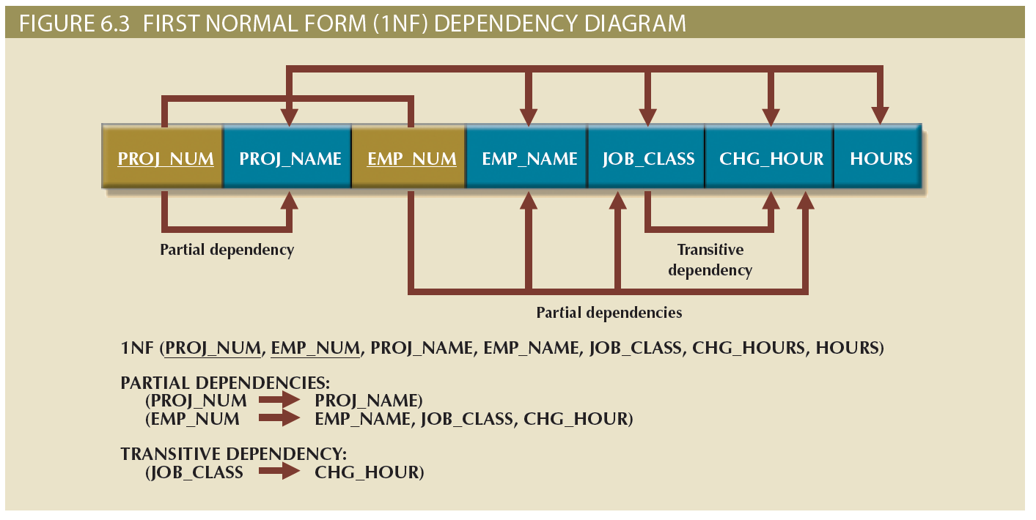
A Dependency Diagram
Copyright © 2017 Cengage Learning
12

Slide 13
Summary
Normalization is part of design process for most organizations
Normalization minimizes data redundancies
Third normal form (3NF) is most commonly required
Copyright © 2017 Cengage Learning
13

Slide 14
Task
Explain why the following relation is not in 1NF
Painters(PainterID, PainterFname, PainterLname,
Paintings (PaintingID, Title, Date, Notes))
Copyright © 2017 Cengage Learning
14

